Slide 1
Instance Generator
Figures and Results

Slide 2
Preliminary Stage

Slide 3
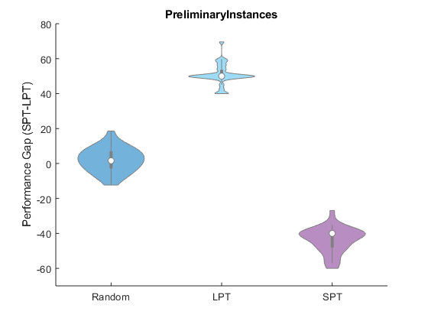

Slide 4
Initial Stage

Slide 5
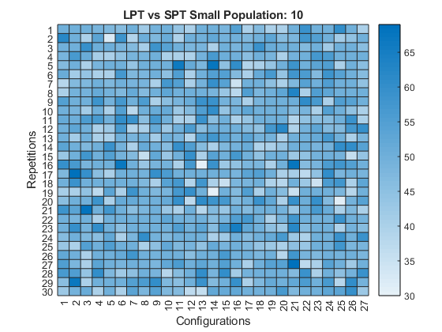

Slide 6
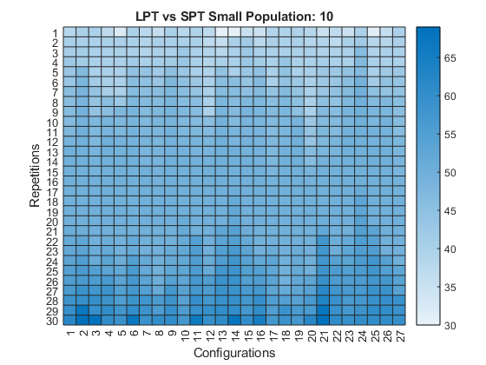

Slide 7
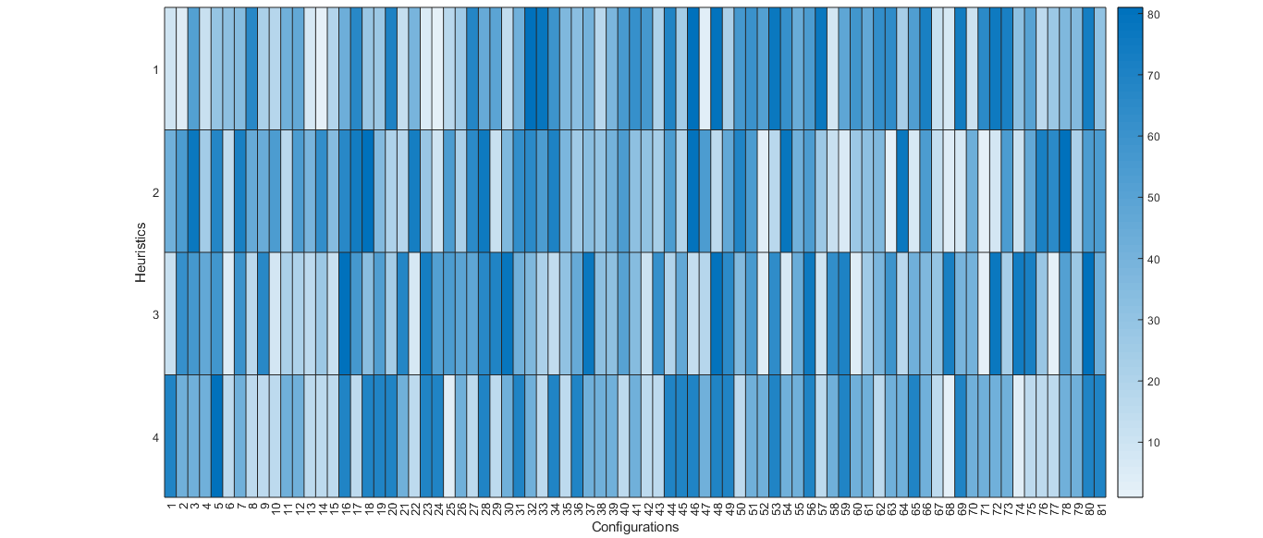
Ranked Median Values

Slide 8
Ranked Median Values Parameters

Slide 9
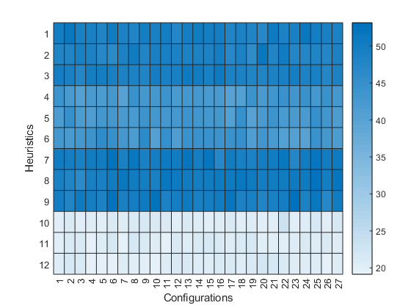
Average Mean Values

Slide 10
Average Mean Values Parameters

Slide 11
Advanced Stage

Slide 12
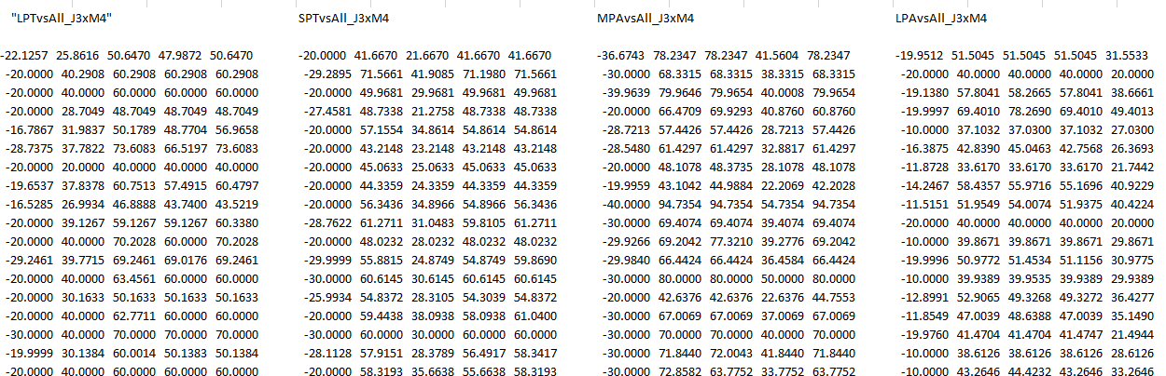
Performance Data

Slide 13
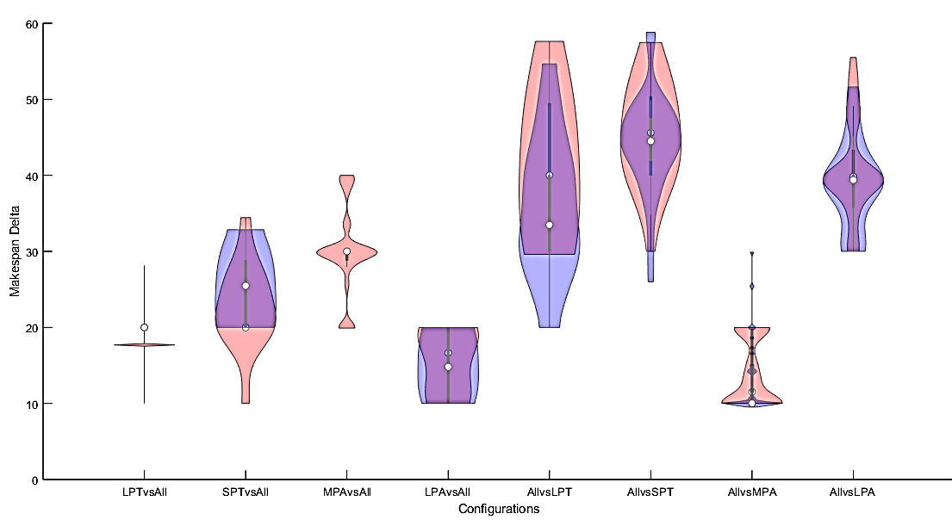
Advanced Instances Violins

Slide 14
Advanced Instances Medians

Slide 15
Parameters Results

Slide 16
Delta Stage

Slide 17
Ranked Median Values Performance Data

Slide 18
Average Mean Values Performance Data

Slide 19
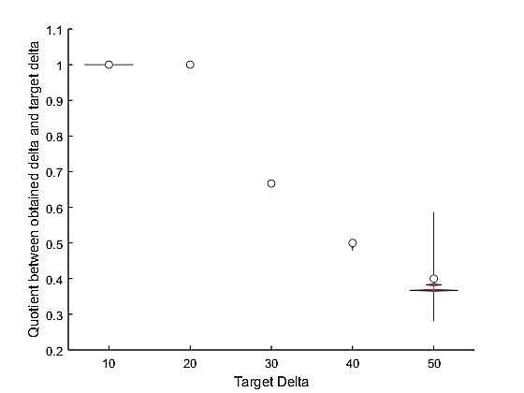
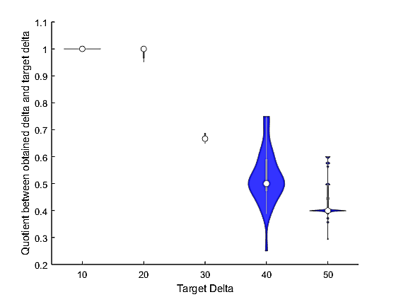
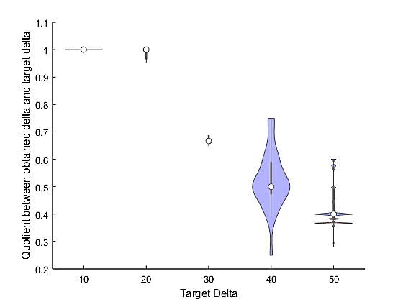
LPTvsAll

Slide 20
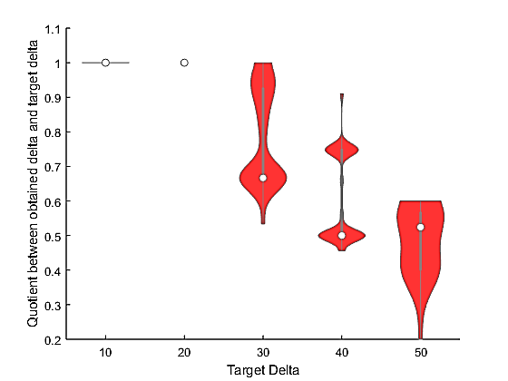
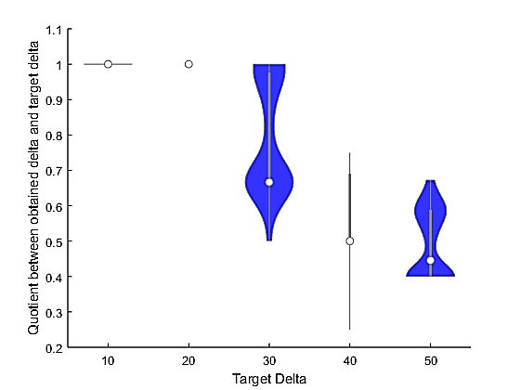
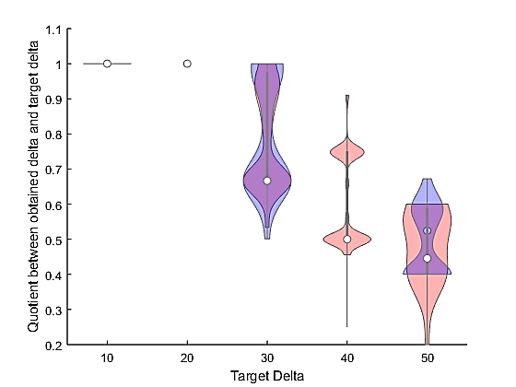
SPTvsAll

Slide 21
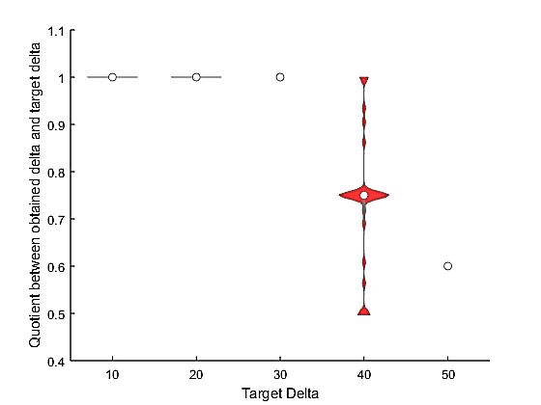
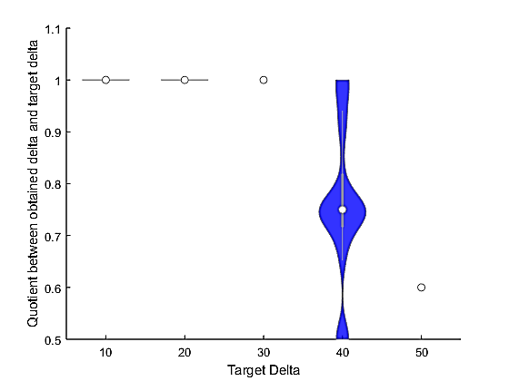
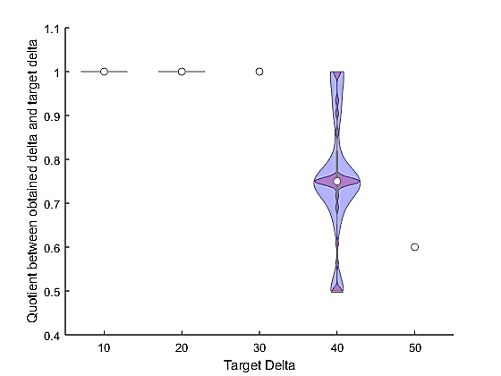
MPAvsAll

Slide 22
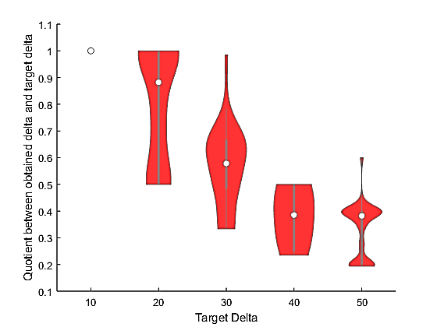
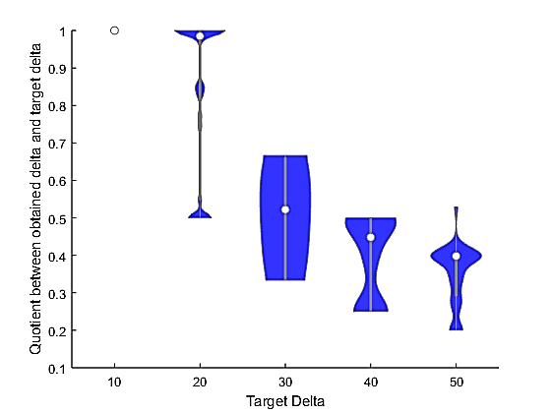
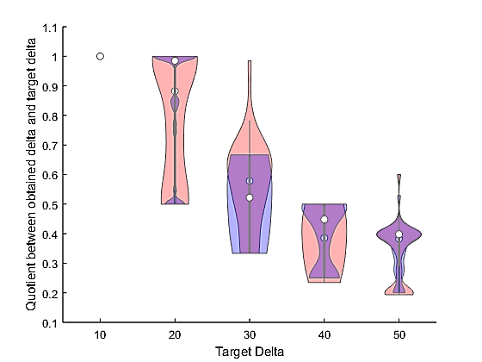
LPAvsAll
Notes:
*selected

Slide 23
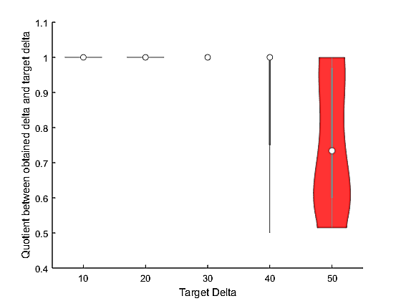
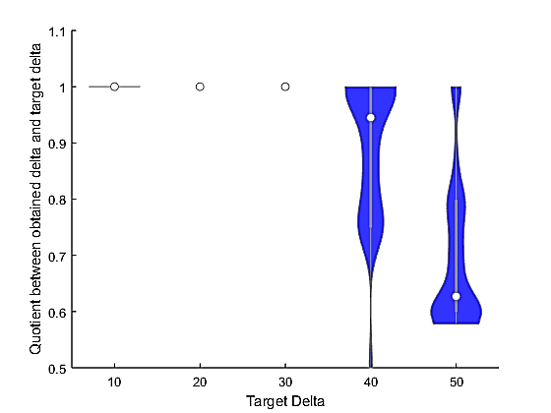
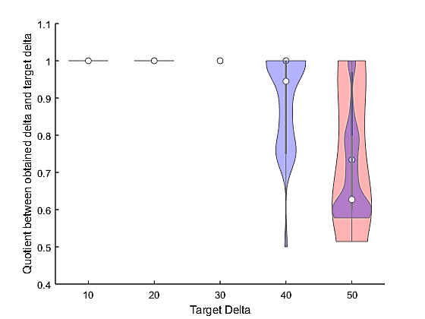
AllvsLPT

Slide 24
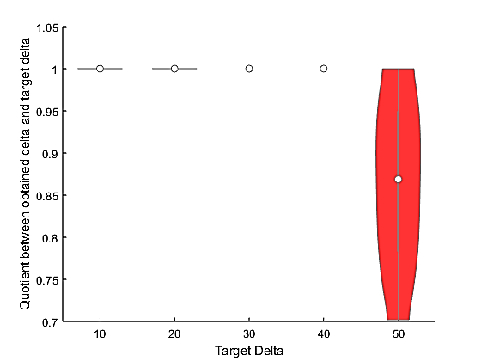
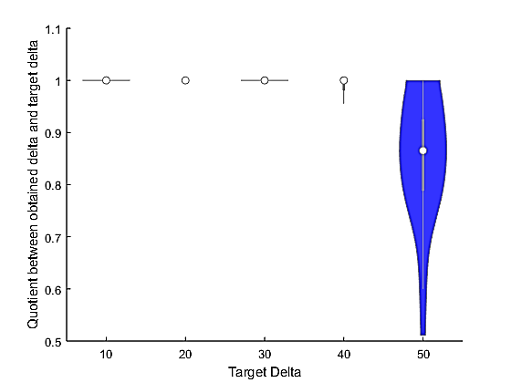
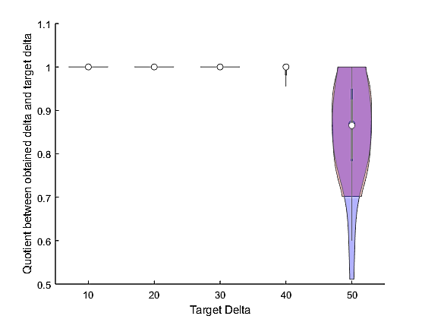
AllvsSPT
Notes:
Selected

Slide 25
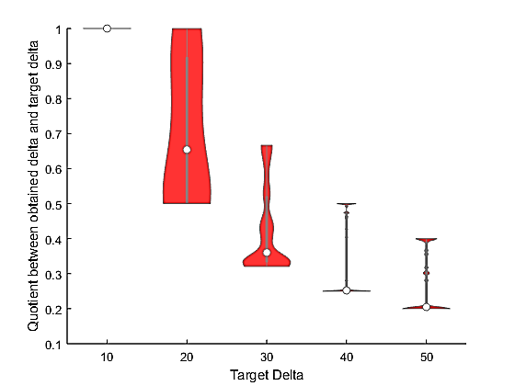
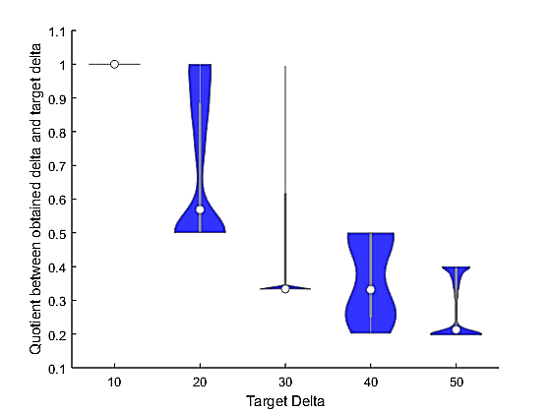
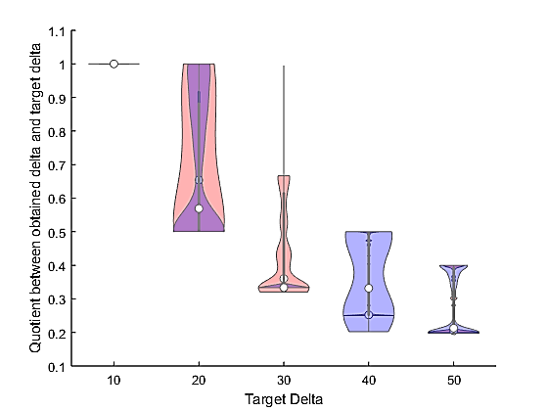
AllvsMPA

Slide 26
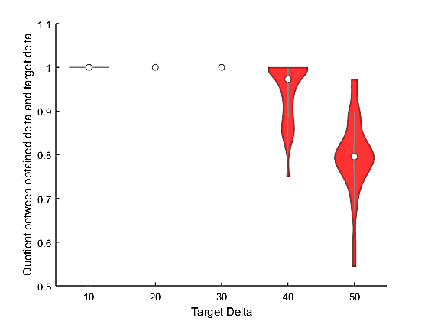
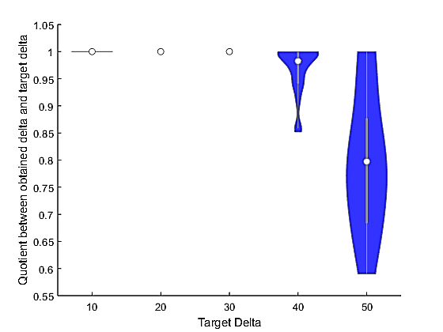
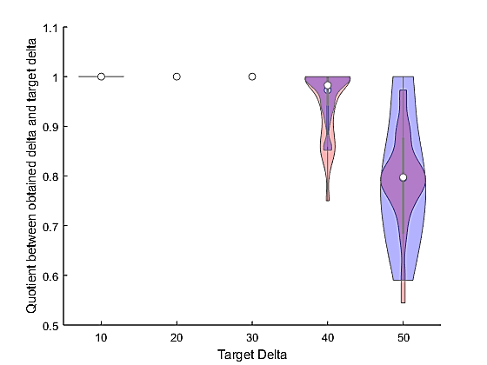
AllvsLPA

Slide 27
Delta Stage Parameters
Notes:
*selected

Slide 28
Final Parameters

Slide 29
Final Parameters
Notes:
*selected
If making delta instances,
LPAvsAll change to: pop 10 SC 2.5 GC 2.5 UF 0.9
AllvsLPA change to: pop 10 SC 1.5 GC 1.5 UF 0.1

Slide 30
Confirmatory Stage

Slide 31
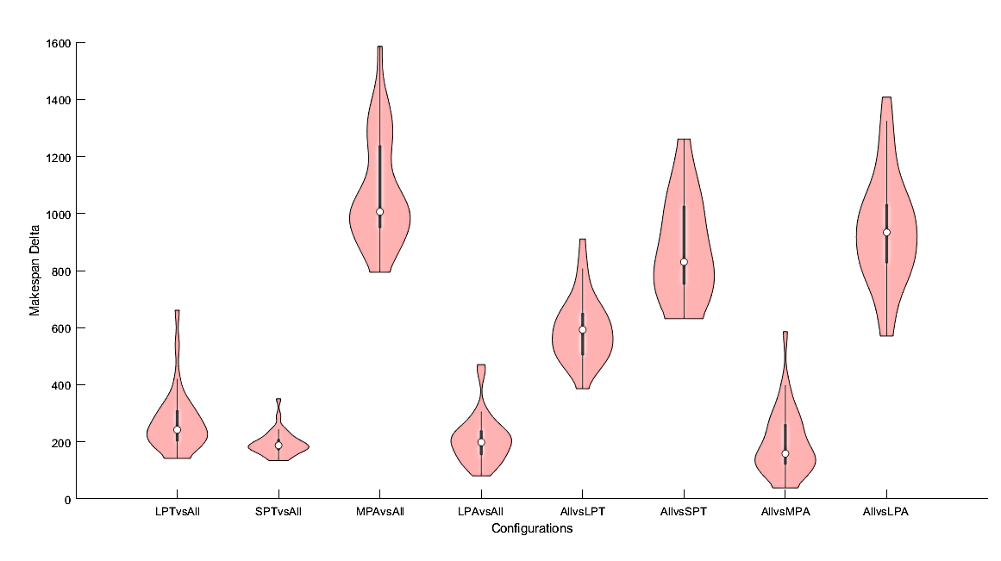
10x10 Instances
Notes:
Ver en que porcentajes de ALLvsLPT, ALLvsSPT, ALLvsLPA, MPA es la ganadora.
Ver como se comportan las otras heurísticas en MPA vs All

Slide 32
Features’ Stage

Slide 33
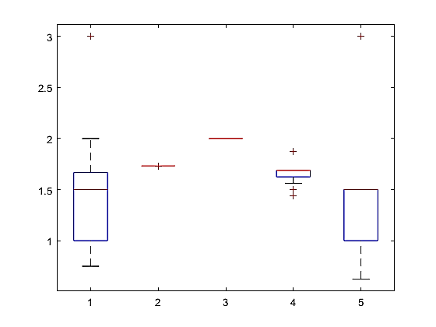
Maximized Features

Slide 34
Normalized Features

Slide 35
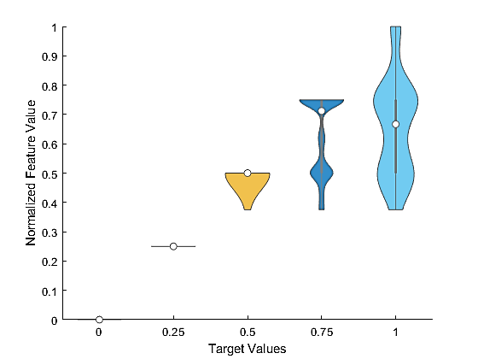
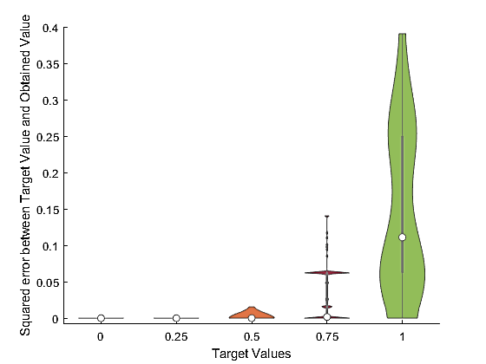
Mirsh 175

Slide 36
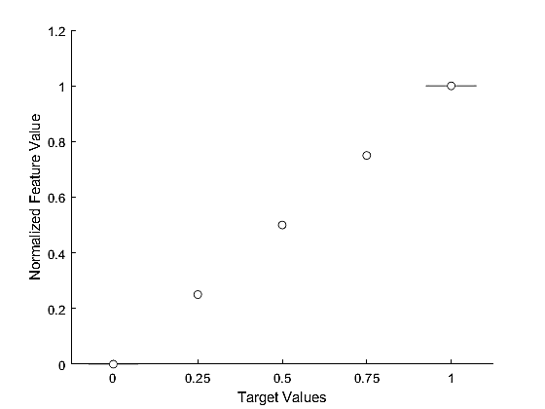
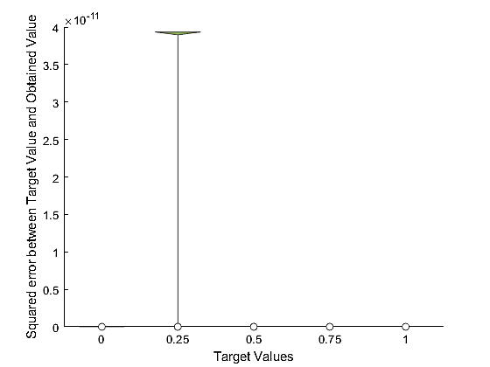
Mirsh 15
Notes:
*selected

Slide 37
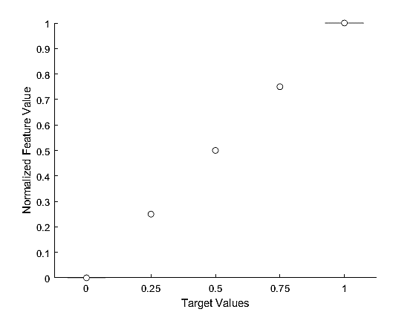
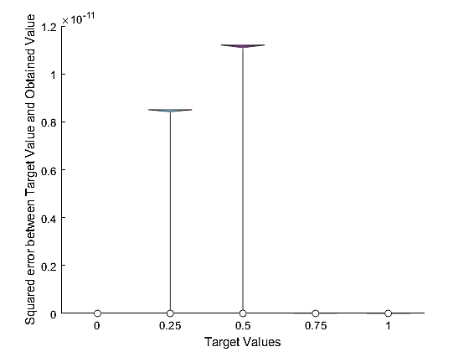
Mirsh 29

Slide 38
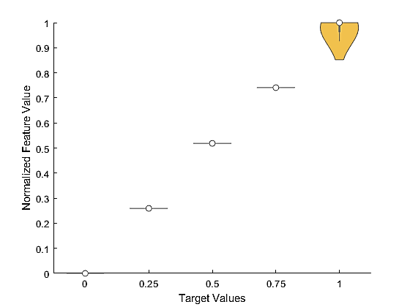
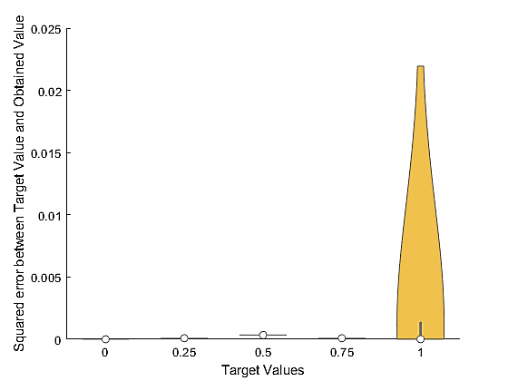
Mirsh 289

Slide 39
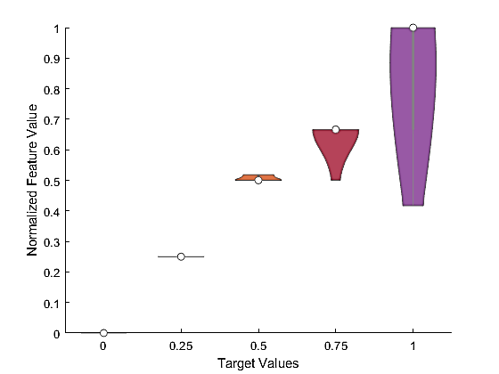
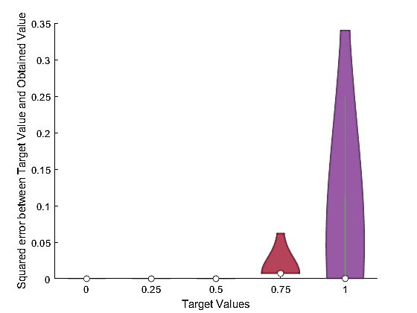
Mirsh 95
Notes:
*selected

Slide 40
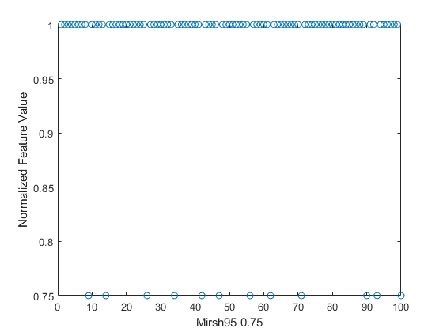
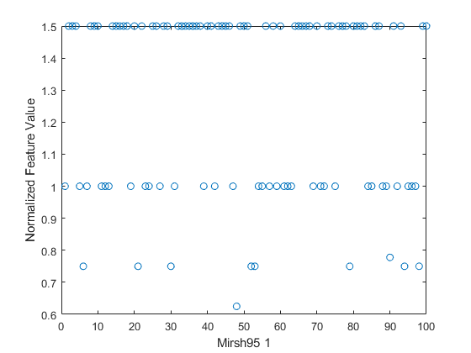
Mirsh 95
Notes:
*selected

Slide 41
SCATTER PLOTS

Slide 42
Code
LPT
AllvsOne
SPT
OnevsAll
MPA
LPA

Slide 43
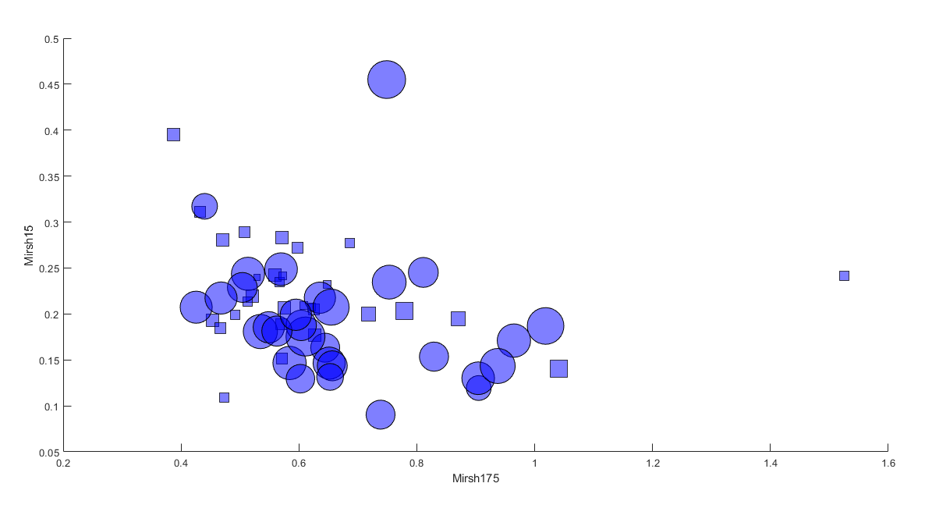

Slide 44
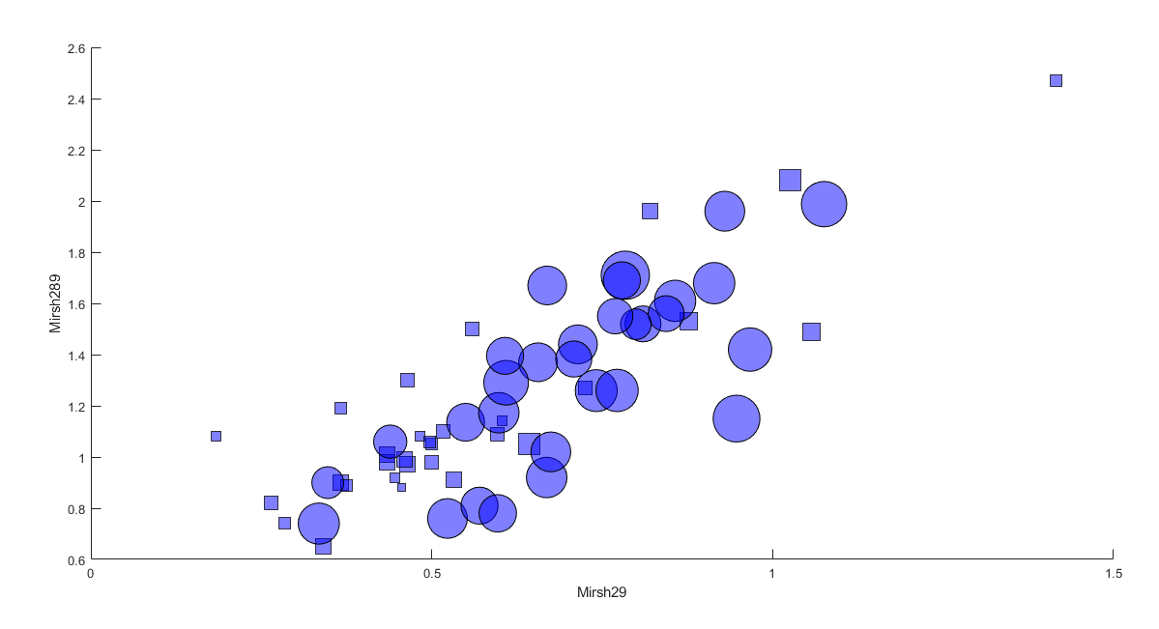

Slide 45
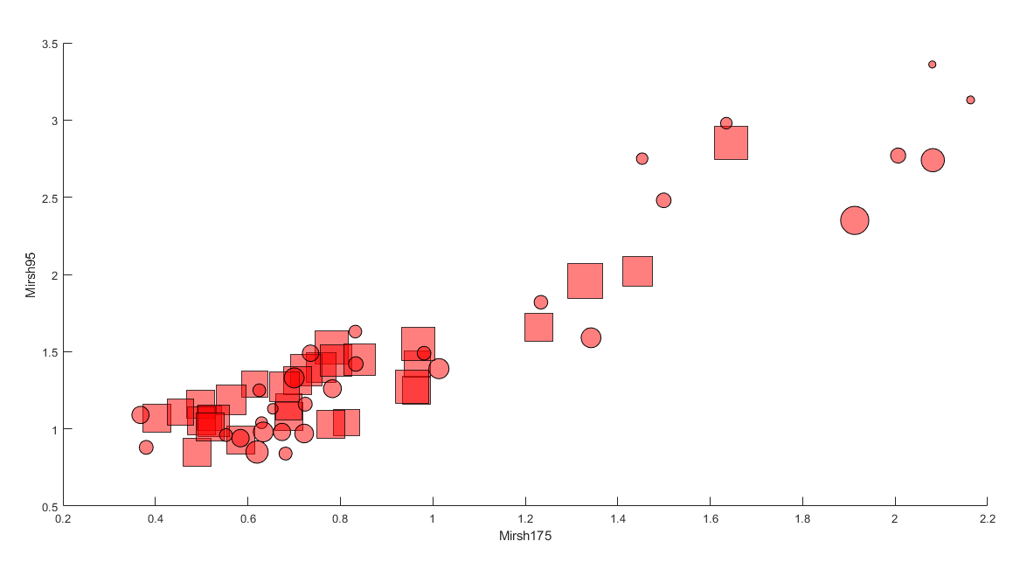

Slide 46
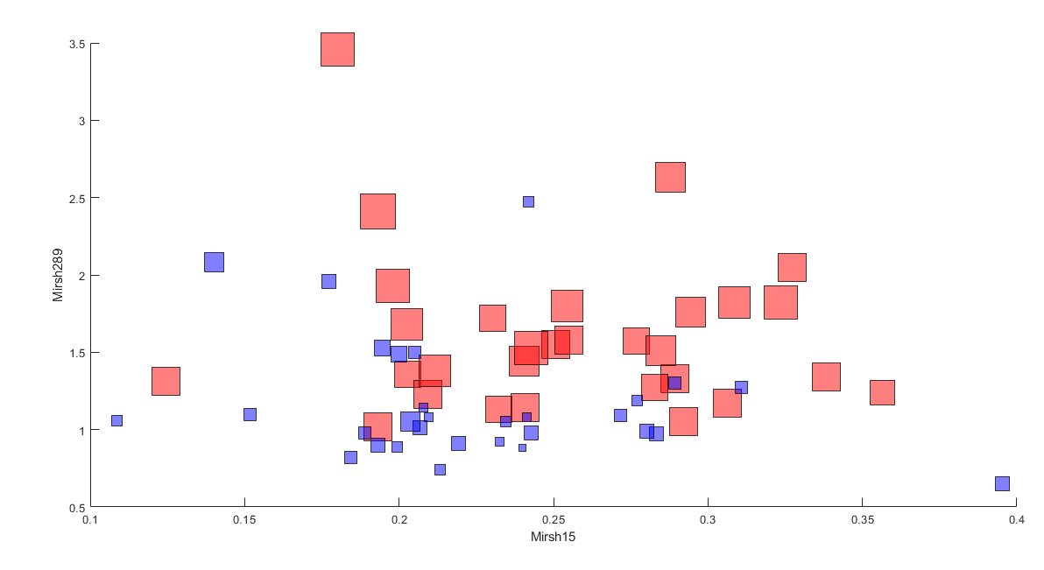

Slide 47
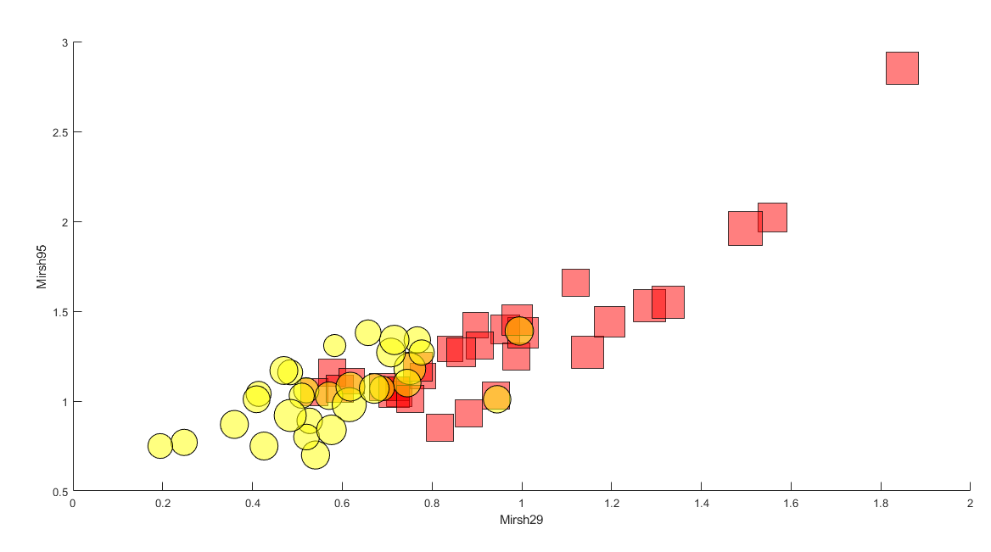
Notes:
Analizar en las instancias de MPAvsAll y AllvsLPT como se comportan LPT y MPA respectivamente, para respaldar la información de esta imagen.

Slide 48
SCATTER PLOTS Feature Instances

Slide 49

Mirsh 175 F1vsF1

Slide 50

Mirsh 175 F1vsF2

Slide 51

Mirsh 175 F1vsF3

Slide 52

Mirsh 175 F1vsF4

Slide 53

Mirsh 175 F1vsF5

Slide 54

Mirsh 15 F2vsF1

Slide 55

Mirsh 15 F2vsF2

Slide 56

Mirsh 15 F2vsF3

Slide 57

Mirsh 15 F2vsF4
Notes:
*selected

Slide 58

Mirsh 15 F2vsF5

Slide 59

Mirsh 29 F3vsF1

Slide 60

Mirsh 29 F3vsF2

Slide 61

Mirsh 29 F3vsF3

Slide 62

Mirsh 29 F3vsF4
Notes:
*selected

Slide 63

Mirsh 29 F3vsF5

Slide 64

Mirsh 282 F4vsF1

Slide 65

Mirsh 282 F4vsF2

Slide 66

Mirsh 282 F4vsF3

Slide 67

Mirsh 282 F4vsF4

Slide 68

Mirsh 282 F4vsF5

Slide 69

Mirsh 95 F5vsF1

Slide 70

Mirsh 95 F5vsF2

Slide 71

Mirsh 95 F5vsF3

Slide 72

Mirsh 95 F5vsF4

Slide 73

Mirsh 95 F5vsF5

Slide 74
SCATTER PLOTS LPT

Slide 75


Slide 76


Slide 77


Slide 78
SCATTER PLOTS SPT

Slide 79


Slide 80


Slide 81

Notes:
*selected

Slide 82
SCATTER PLOTS MPA

Slide 83


Slide 84


Slide 85

?

Slide 86
SCATTER PLOTS LPA

Slide 87

?

Slide 88
3D PLOTS 10X10 Heuristic Instances

Slide 89
LPT

Slide 90


Slide 91
SPT

Slide 92


Slide 93


Slide 94


Slide 95


Slide 96
MPA

Slide 97


Slide 98
LPA

Slide 99


Slide 100
More 3D PLOTS 10X10 Heuristic Instances

Slide 101


Slide 102


Slide 103


Slide 104


Slide 105


Slide 106


Slide 107


Slide 108


Slide 109


Slide 110


Slide 111


Slide 112


Slide 113


Slide 114


Slide 115


Slide 116
Scatter Plot 2D Deltas

Slide 117

LPTvsAll

Slide 118

LPTvsAll

Slide 119

LPTvsAll

Slide 120

LPTvsAll

Slide 121

SPTvsAll

Slide 122

SPTvsAll

Slide 123

AllvsSPT

Slide 124

AllvsSPT

Slide 125
LPAvsAll

Slide 126

AllvsLPA
Notes:
*selected

Slide 127

AllvsMPA

Slide 128

MPAvsAll
Notes:
*selected

Slide 129
Uso de Recursos

Slide 130

Confirmatory Instances
Notes:
*selected

Slide 131

Mirsh175
Notes:
*selected

Slide 132

Mirsh15
Notes:
*selected

Slide 133

Mirsh29
Notes:
*selected

Slide 134

Mirsh282
Notes:
*selected

Slide 135

Mirsh95
Notes:
*selected

Slide 136
MPAvsAll_AllvsLPT F3_F5 Analysis

Slide 137

Notes:
*selected

Slide 138

Notes:
*selected

Slide 139
MPA Plots

Slide 140


MPAvsAll
AllvsMPA
Notes:
*selected

Slide 141


MPAvsAll
AllvsMPA
Notes:
*selected

Slide 142


MPAvsAll
AllvsMPA
Notes:
*selected

